Slide 1
18CSC206J-Software Engineering and Project Management
4th Semester
Project Topic: Computer Shop Management System
Team Members:
Saurabh Raj (RA2011031010107)

Slide 2

To keep pace with time, to bring about the best result without malfunctioning and greater efficiency so to replace the unending heaps of files with a much sophisticated hard disk of the computer. One has to use the data management software.
Software has been an ascent in atomization various organizations.
The History:

Slide 3

Introduction:
Computer-shop management System is a project which assist in keeping the Record of whatever the sales from shop (whole seller), also it keep track of remaining balance which due after selling the product. Through this project we maintain the discount given on particular products along with complete information related to that product.
Computer-shop management System is software for store billing management. Sell hardware systems components and accessories (keep track of sold configurations, create system configuration, sell accessories and computer components, supplying company’s administration, and many more...). Computer-shop management System is a windows based billing software designed for uses in computer stores.

Slide 4

The project:
This project introduces Computer Shop Billing System.
It explains how transaction is being done in computer shop.
This project is developed in c++ language.

Slide 5
Approach:
A better project planning and management.
Concept development
Good coding skills is required in c/c++ language.
One should also have good knowledge of data structures.
Benefits:
Data management initially had to maintain a lot of ledgers and a lot of paper work to be done but now using software product on this organisation has made their work faster and easier.
Now only this software has to be loaded on computer and work can be done. This prevents lot of time and money.

Slide 6
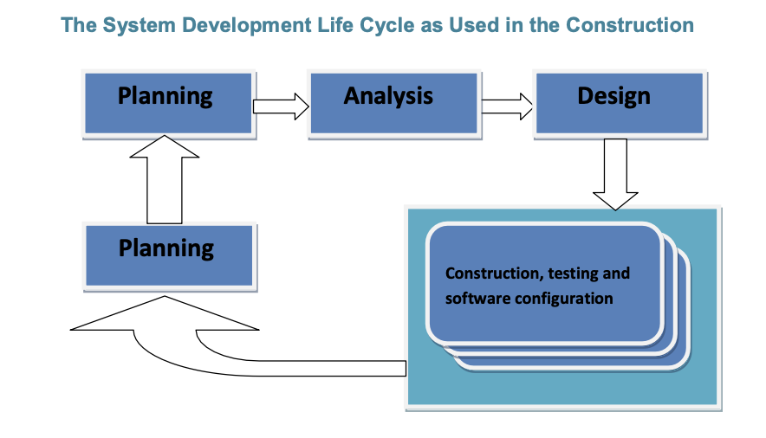
Life Cycle:

Slide 7
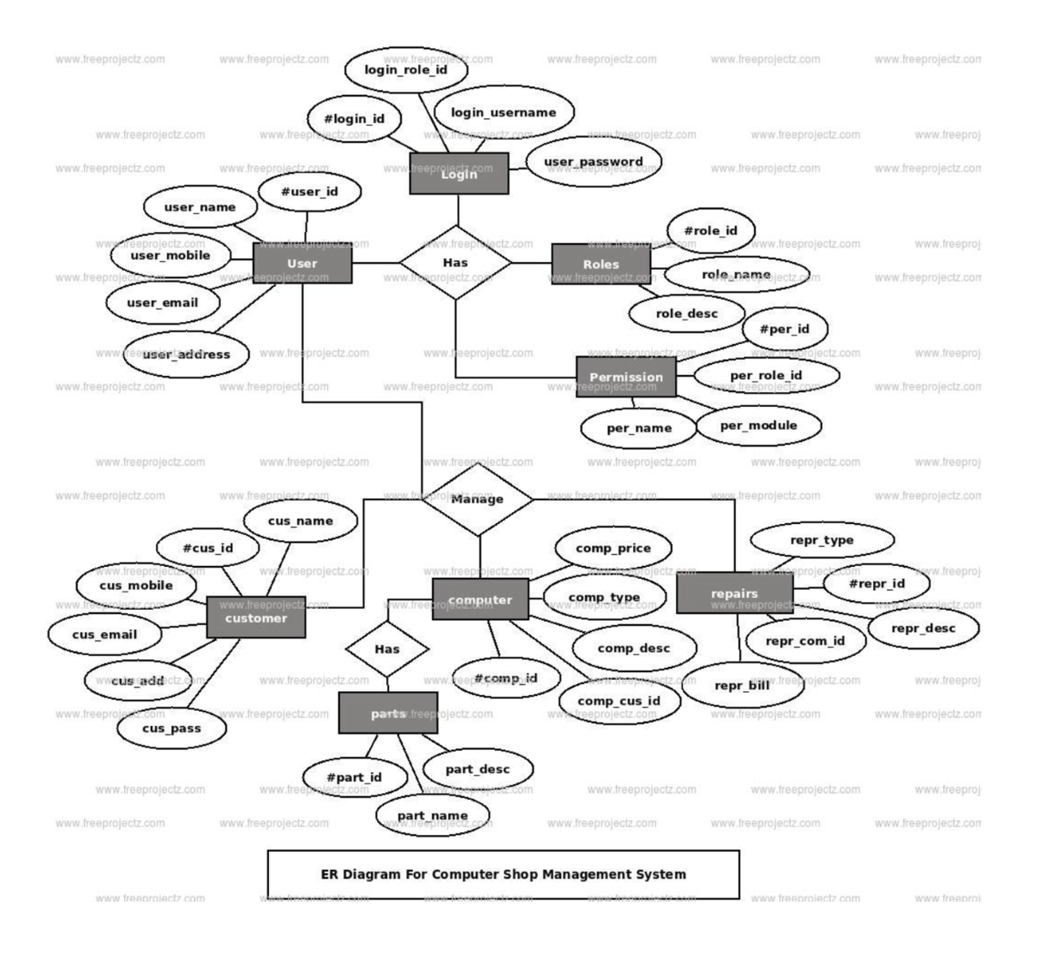

Slide 8
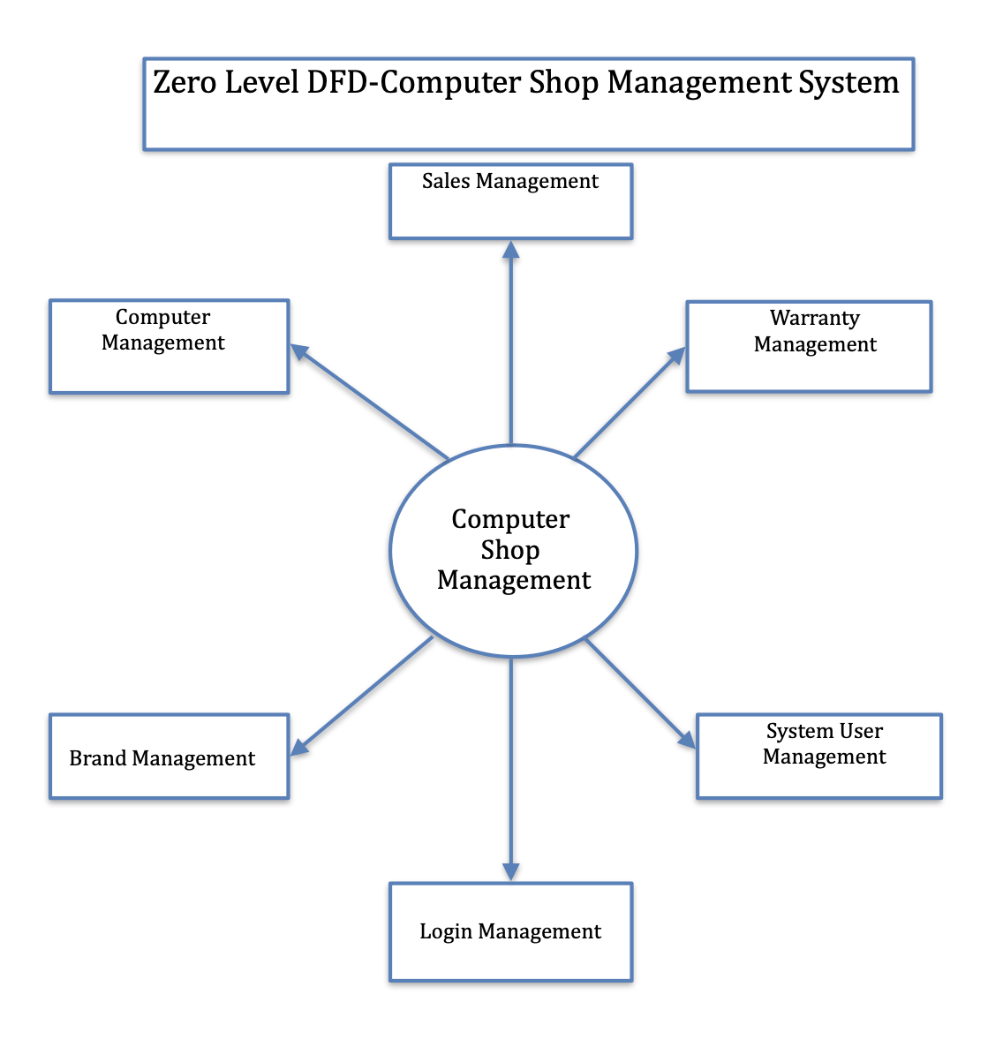
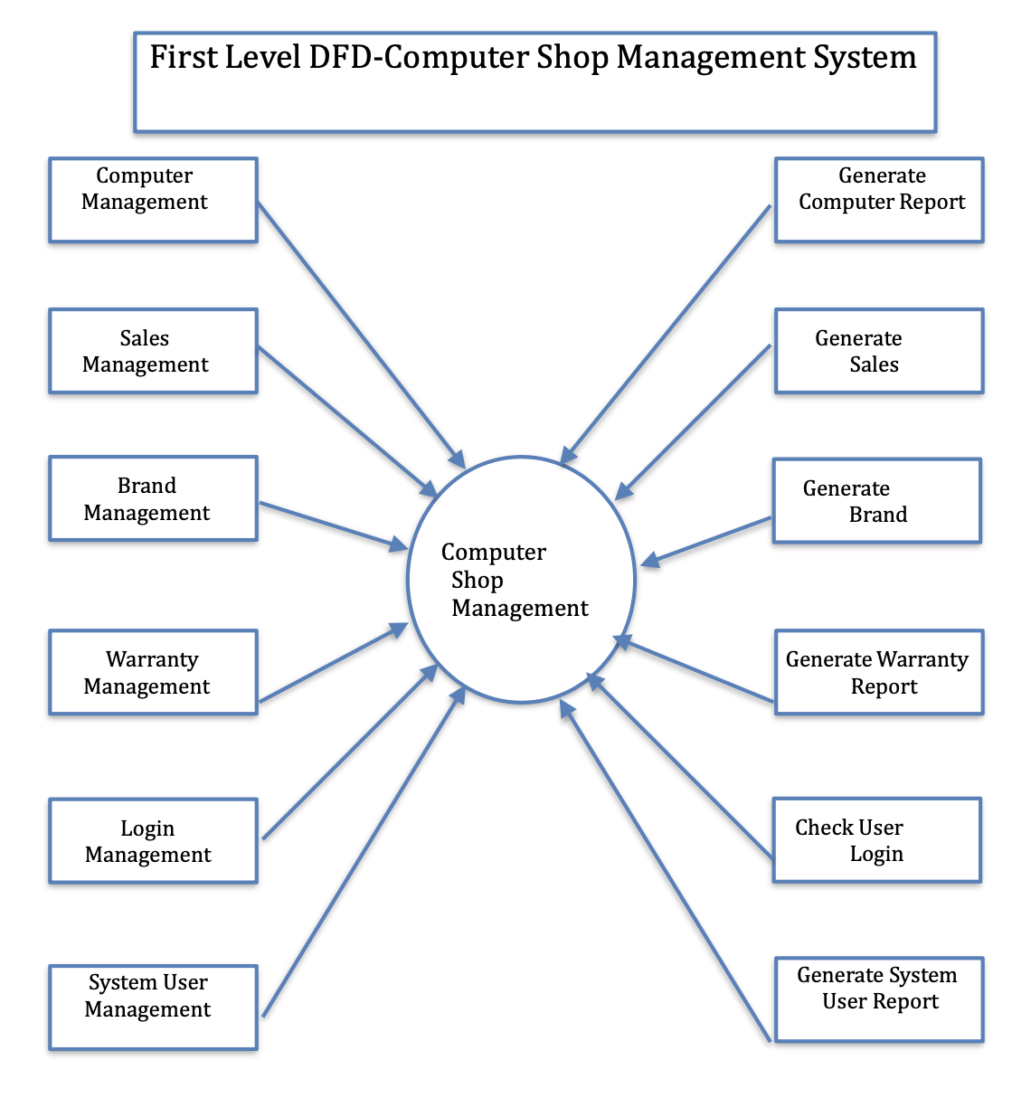
Data Flow Diagram:

Slide 9
Objective:
The objective of my project to provides management facility to computer shop. We have given many facilities for users in this project.
Welcome screen
Login screen
Main form
Add Computer System parts
Modify Computer System parts
Update Computer System parts
Delete Computer System parts
Report of computer part
Report of sold computer parts invoice
Report of a particular computer parts

Slide 10
System Crash : One of the biggest problems with any computerized system is the potential for a system crash.
Malicious Hacks : Hackers look for any way to get company or consumer information.
Lack of training
Limitations:

Slide 11
Conclusion:
The project has covered almost all the requirements. Further requirements and improvements can easily be done since the coding is mainly structured or modular in nature. Improvements can be appended by changing the existing modules. We think that not a single project is ever considered as complete forever because our mind is always thinking new and our necessities also are growing. Our application also, if you see at the first glance that you find it to be complete but we want to make it still mature and fully automatic.
As system is flexible you can generate more report and screen as and when required. The system is modified in future as per the owner requirement. In this system we can add more reports about users so more and more Information about computer parts.

Slide 12
REFERENCES:
The C++ Programming Language , 3rd Edition / Stroustrup Addison-Wesley.
C++ Primer, 3rd Edition / Lippman and Lajoie Addison-Wesley. The Scott Meyers series, Addison-Wesley:
Effective C++ : 50 Specific Ways to Improve Your Programs and Designs, 2nd Edition
More Effective C++ : 35 New Ways to Improve Your Programs and Designs and Effective STL: 50 Specific Ways to Improve Your Use of the Standard Template Library
Beginners' C++ Course, 3rd Edition Ron Wein
———————————————————————————————————————————
END

